Slide 1

Prospective and Retrospective Provenance Queries Using YesWorkflow, RDF, and SPARQL
Linh Hoang, Hui Lyu, Timothy McPhillips and Bertram Ludäscher

Slide 2
Motivation
DataONE
DataONE is a community driven project providing access to data across multiple member repositories, supporting enhanced search and discovery of Earth and environmental data.
Research projects in DataONE are using RDF to provide provenance from OAI-ORE* data packages.
* OAI-ORE: Open Archives Initiative Object Exchange and Reuse

Slide 3
Motivation (cont.)
YesWorkflow
Defines a set of annotations for declaring the expected dataflow patterns in scripts written in any text-based programming language.
YW builds a workflow model of the script based on these annotations, revealing the computational modules and dataflow dependencies in the script.
YW can capture additional script-related artifacts, i.e., not only the workflow graph (prospective provenance) but also runtime observables (retrospective provenance) that can be queried by Prolog & DataLog.

Slide 4
Motivation (cont.)
Project Goals
Allow YW-captured provenance information be easy to query together with other available provenance information which is already in RDF format.
Enable all of the provenance information that can be collected by YesWorkflow and exported to Prolog facts, to be exported alternatively to an RDF representation.
Produce RDF documents that are both easy to read directly and also easy to query using SPARQL.

Slide 5
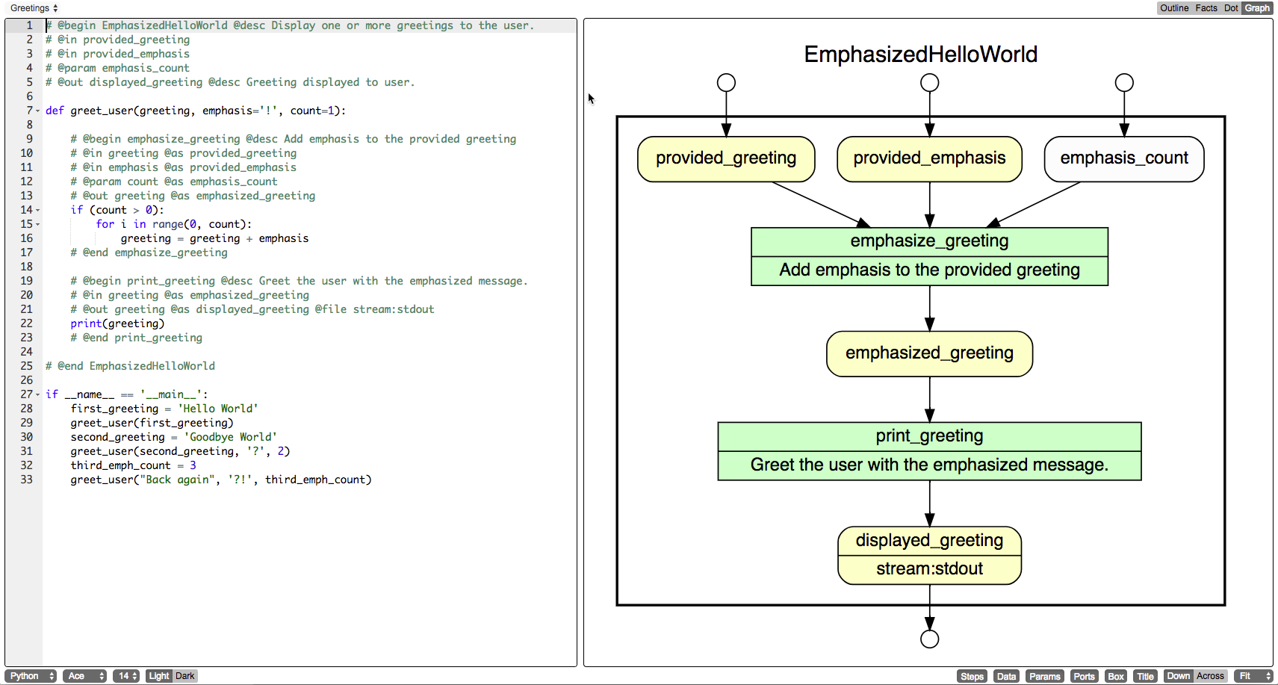
YesWorkflow Overview – How it works?

Slide 6
YesWorkflow Overview (cont.) – Existing query capabilities
Fact files:
Question: What is the name of the top-level workflow?
Query (DLV):
mq2(WorkflowName) :- workflow(W), program(W, WorkflowName,_, _, _).

Slide 7
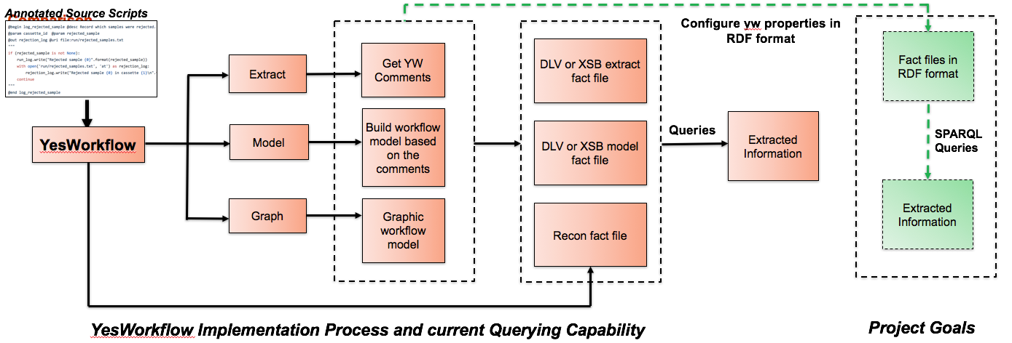
YesWorkflow Overview (cont.)

Slide 8
Approach / Method
Conceptualized RDF model that captures the provenance related portions of YesWorkflow.
“Hand-crafted” RDF document based on the model for a specific YW example.
Wrote SPARQL queries to mimic existing (working) Prolog/Datalog queries to ensure that the RDF model can support the same queries.
Using two different RDF query engines (ARQ, Virtuoso) to test the queries.
*Note: the four steps were implemented iteratively.

Slide 9
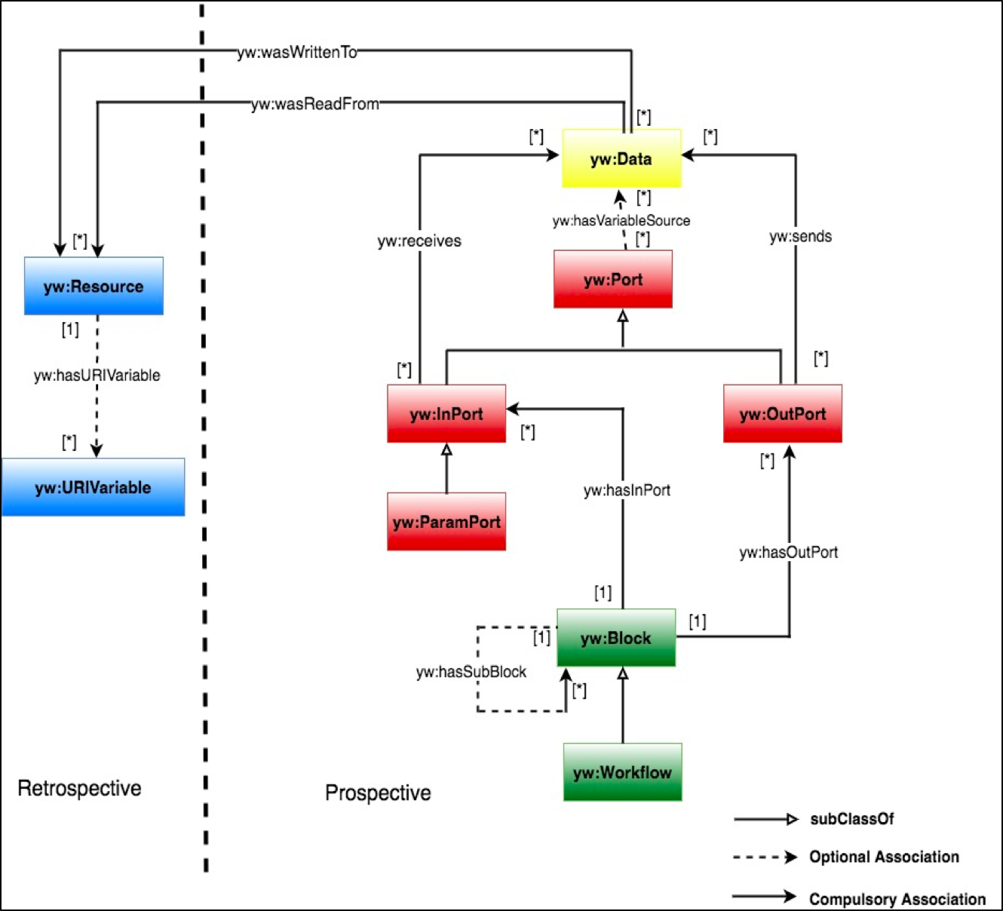
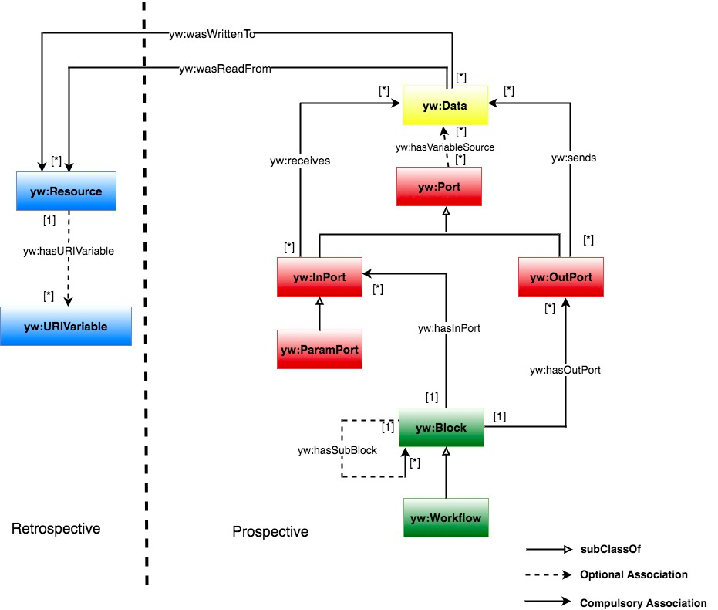
(1) Conceptualized RDF Model
Prospective information:
Block which represents for computational tasks in the script.
Port which represents for the connecting points in which blocks sending or receiving data to each other.
Data which represents for the data that flows between blocks via ports through out the script.
Retrospective information:
Resource: which represents for physical instances of data generated during runtime events.
URIVariable: which represents for resource file name with its path.
Notes:
@Tim: Why this isn’t the full YW model

Slide 10
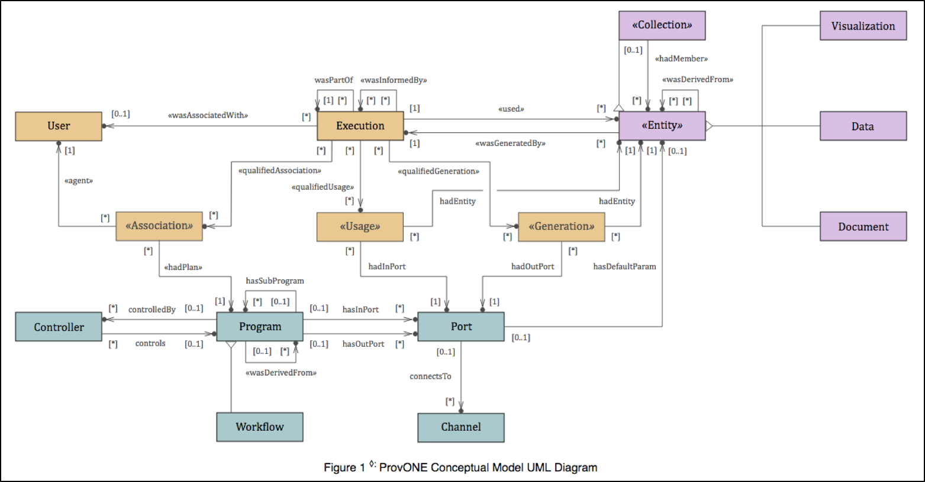
Mapping with ProvONE (A PROV Extension Data Model for Scientific Workflow Provenance). Details here
(1) Conceptualized RDF Model (cont.)

Slide 11
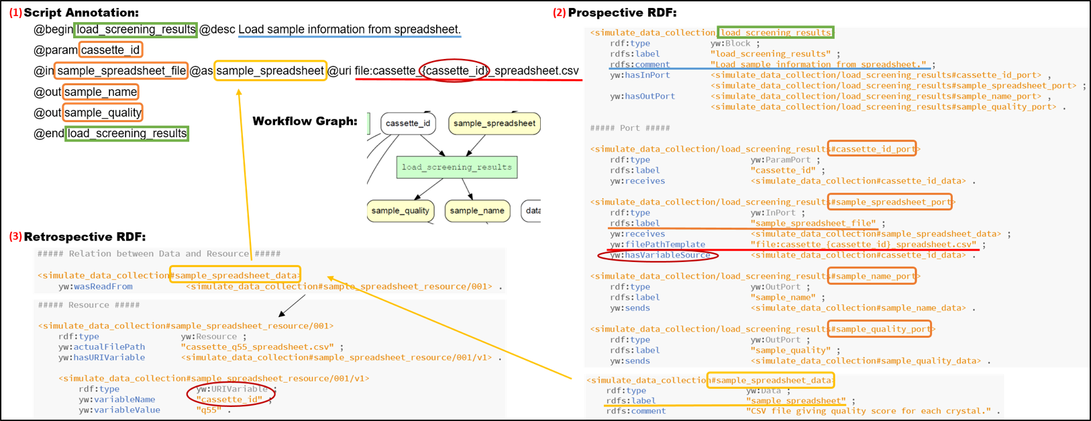
(2) “Hand crafted” RDF Representation

Slide 12
(3) (4) Wrote and tested SPARQL queries
List of queries here
Using 2 tools Jena-ARQ and Virtuoso to test the queries.
Example 1: Recursive query using SPARQL property path
Question: What are the downstream blocks of the program block named “B1”?
Query:
SELECT DISTINCT ?downstream_block_name
WHERE
{ ?block rdf:type yw:Block;
rdfs:label "B1".
?block (yw:hasOutPort/yw:sends/^yw:receives/^yw:hasInPort)+ ?down_block.
?down_block rdf:type yw:Block;
rdfs:label ?downstream_block_name.
} ORDER BY ?down_block_name;

Slide 13
(3) (4) Wrote and tested SPARQL queries
Example 2: Querying across between prospective and retrospective provenance
Question: What URI variable value that associated with a data named “D1”?
Query:
SELECT DISTINCT ?variable_value
WHERE
{ ?data rdf:type yw:Data ;
rdfs:label "D1" ;
(yw:wasReadFrom|yw:wasWrittenTo) ?resource.
?resource rdf:type yw:Resource;
yw:hasURIVariable ?URIVariable .
?URIVariable rdf:type yw:URIVariable;
yw:variableValue ?variable_value.}

Slide 14
Findings
Observations:
ARQ vs. Virtuoso:
ARQ took longer time to run all the queries (about 30 seconds). Whereas, Virtuoso is much faster (less than 5 seconds).
ARQ require special syntax declaration in order to use advanced property path queries: https://jena.apache.org/documentation/query/property_paths.html.
Property path works nicely (somewhat more handful than in Prolog & Datalog).
No is-a hierarchy for free (i.e: owl:sameAs, rdfs:subClassOf).
Challenges
Mapping between ProvONE & YW RDF Model: not all ProvONE components are applicable to use in YW RDF.
More real samples (scripts) to test the feasibility of RDF model & queries.

Slide 15
Plans for Future Works
Examining the feasibility of YW RDF model, RDF representation & SPARQL queries with new samples (Python, R scripts anyone?)
Defining “meaningful” queries that can be used by researchers.
Judgments of using own RDF vocabulary instead of standard ProvONE vocabulary (via an example?).

Slide 16
QUESTIONS?

Slide 17
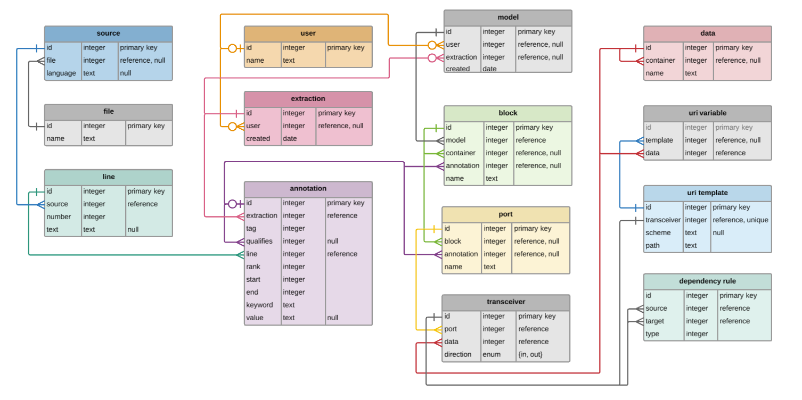
YesWorkflow Overview (cont.)
YW Relational Schema (annotation & wf model)

Slide 18
Results
Refined the provenance related portion of the existing YW conceptual model, making it compatible with ProvONE*.
Translated the refined parts of YW model to an RDF representation.
Used SPARQL to facilitate scientifically meaningful queries that can be used by researchers.

